Slide 1



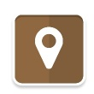


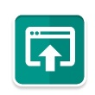
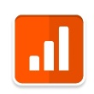


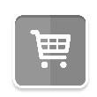

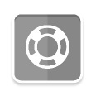


START
MARKETING PLATFORM
GUESTBOOK
GENERATE LEADS
You can collect guest information at free-standing kiosks or tablets throughout your city.
NETWORK YOUR
CALENDARS
INVITE AN AUDIENCE:
After content is loaded into the system, partners can pull that information to automatically generate and build communications in minutes.
Upload your event into the EverWondr cloud.
UPLOAD
SHARE
PROMOTE
NETWORK YOUR
DIRECTORIES
SEND OUT CONTENT:
After filters are applied, content is distributed to partners for display on:
AUTOMATICALLY BUILD EMAILS, PRESS RELEASES AND NEWSLETTERS
Upload your videos, brochures and galleries to the EverWondr cloud.
Event calendars
Directories
Kiosks
Mobile Sites / APPs
Event wires
Wondrbar
Electronic Signage
Social Media Pages
AUTOMATICALLY
BUILD EVENT FLYERS
REVERSE PUBLISH LISTINGS FOR MEDIA
SURVEY
Distribute surveys by embedding them into your site, sending through social media or using at a live event.
VERIFY
TRACK
MAKE MONEY
ANALYZE YOUR RESULTS
Review usage across the network and make refinements as needed.
GENERATE REVENUE:
Use the system to create new revenue streams.
TRACK MONTHLY VIEWS, IMPRESSIONS AND MORE
SELL ADS ACROSS THE NETWORK
GENERATE OFFERS AND COUPONS
REPEAT
COLLECT DONATIONS FOR SPECIAL PROJECTS
SELL TICKETS
REVIEW SOCIAL MEDIA USE AND CONVERSATIONS
ALLOW ARTISTS TO SELL THEIR WORK

